Slide 1
Distributed Complex Event Detection
Paper Reading by Steven Lai

Slide 2
Overview
Title: Distributed Complex Event Detection for Pervasive Computing
Author: Dan O’Keeffe
From: Cambridge University

Slide 3
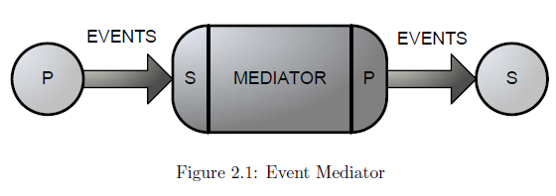
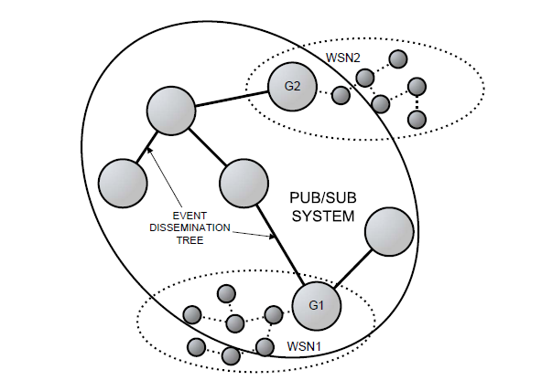
Overview
Event-based middleware
WSN-based event system

Slide 4
Event Language
Syntax:
  CreateCE <ce-name>
  Select <select-expression>
  [Init <context-initiators>]
  Event <complex-event-pattern>
  [Where <conditional-expression>]
  [Term <context-terminators>]
  [GKeys <global-keys>]
  [LKeys <local-keys>]

Slide 5
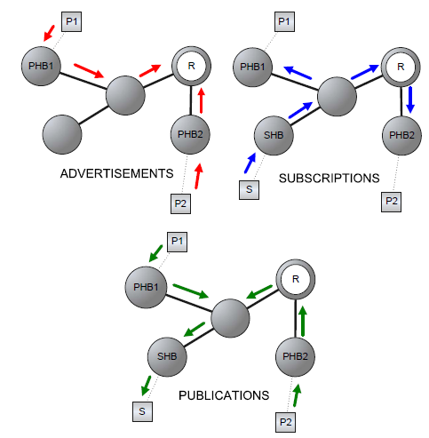
Detector Placement

Slide 6
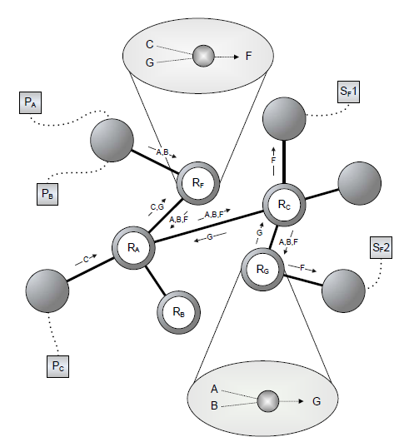
Rendezvous Broker (RV) Placement

Slide 7
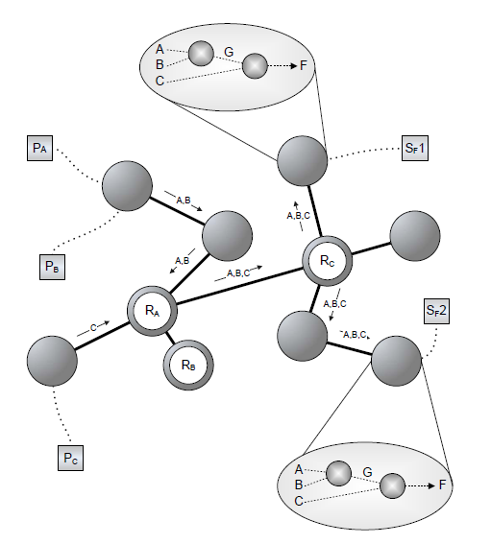
Subscriber Hosting Broker (SHB) Placement

